Slide 1

June 13 Videoconference
Narayanan Jayaraman
Alan Flury
Scheller College of Business

Slide 2
MGT8803 Business Fundamentals for Analytics Video Conference Call #6 Agenda
Course Update
Introduction to Financial Analytical Techniques (Topic 1)
Managerial Accounting Homework Review

Slide 3
MGT8803 Business Fundamentals for Analytics Video Conference Call #6 Course Update
No graded work due this week. Financial Analytical Techniques Homework will be Released Early, Saturday June 15
Financial Analytical Techniques Homework due on Tuesday June 24 at 11:59pm eastern
Next Videoconference will be on Thursday June 20. A brief exam review will be discussed after the Financial Analytical Techniques part of the call is competed (may be a long call)
This week try to complete through Topic 5 in Financial Analytical Techniques
Topic 2 Decision Rules for Capital Investment
Topic 3 Making Capital Investment Decisions
Topic 4 Economic Value Added and Market value Added
Topic 5 Cost of Capital

Slide 4

MGT8803 Business Fundamentals for Analytics Video Conference Call #6 Discussion with Dr. Jayaraman

Slide 5
MGT8803 Business Fundamentals for Analytics Video Conference Call #6
Yahoo.com Assignment
5 Largest US-Based Companies By Market Cap
Mkt Cap Capex
Microsoft $1,008b 11.632b
Amazon $913b 13.427b
Apple $893b 13,313b
Alphabet $748b 25.139b
Berkshire Hathaway $502b 14.537b
As of 10:55pm June 12
1
2
3
4
5

Slide 6
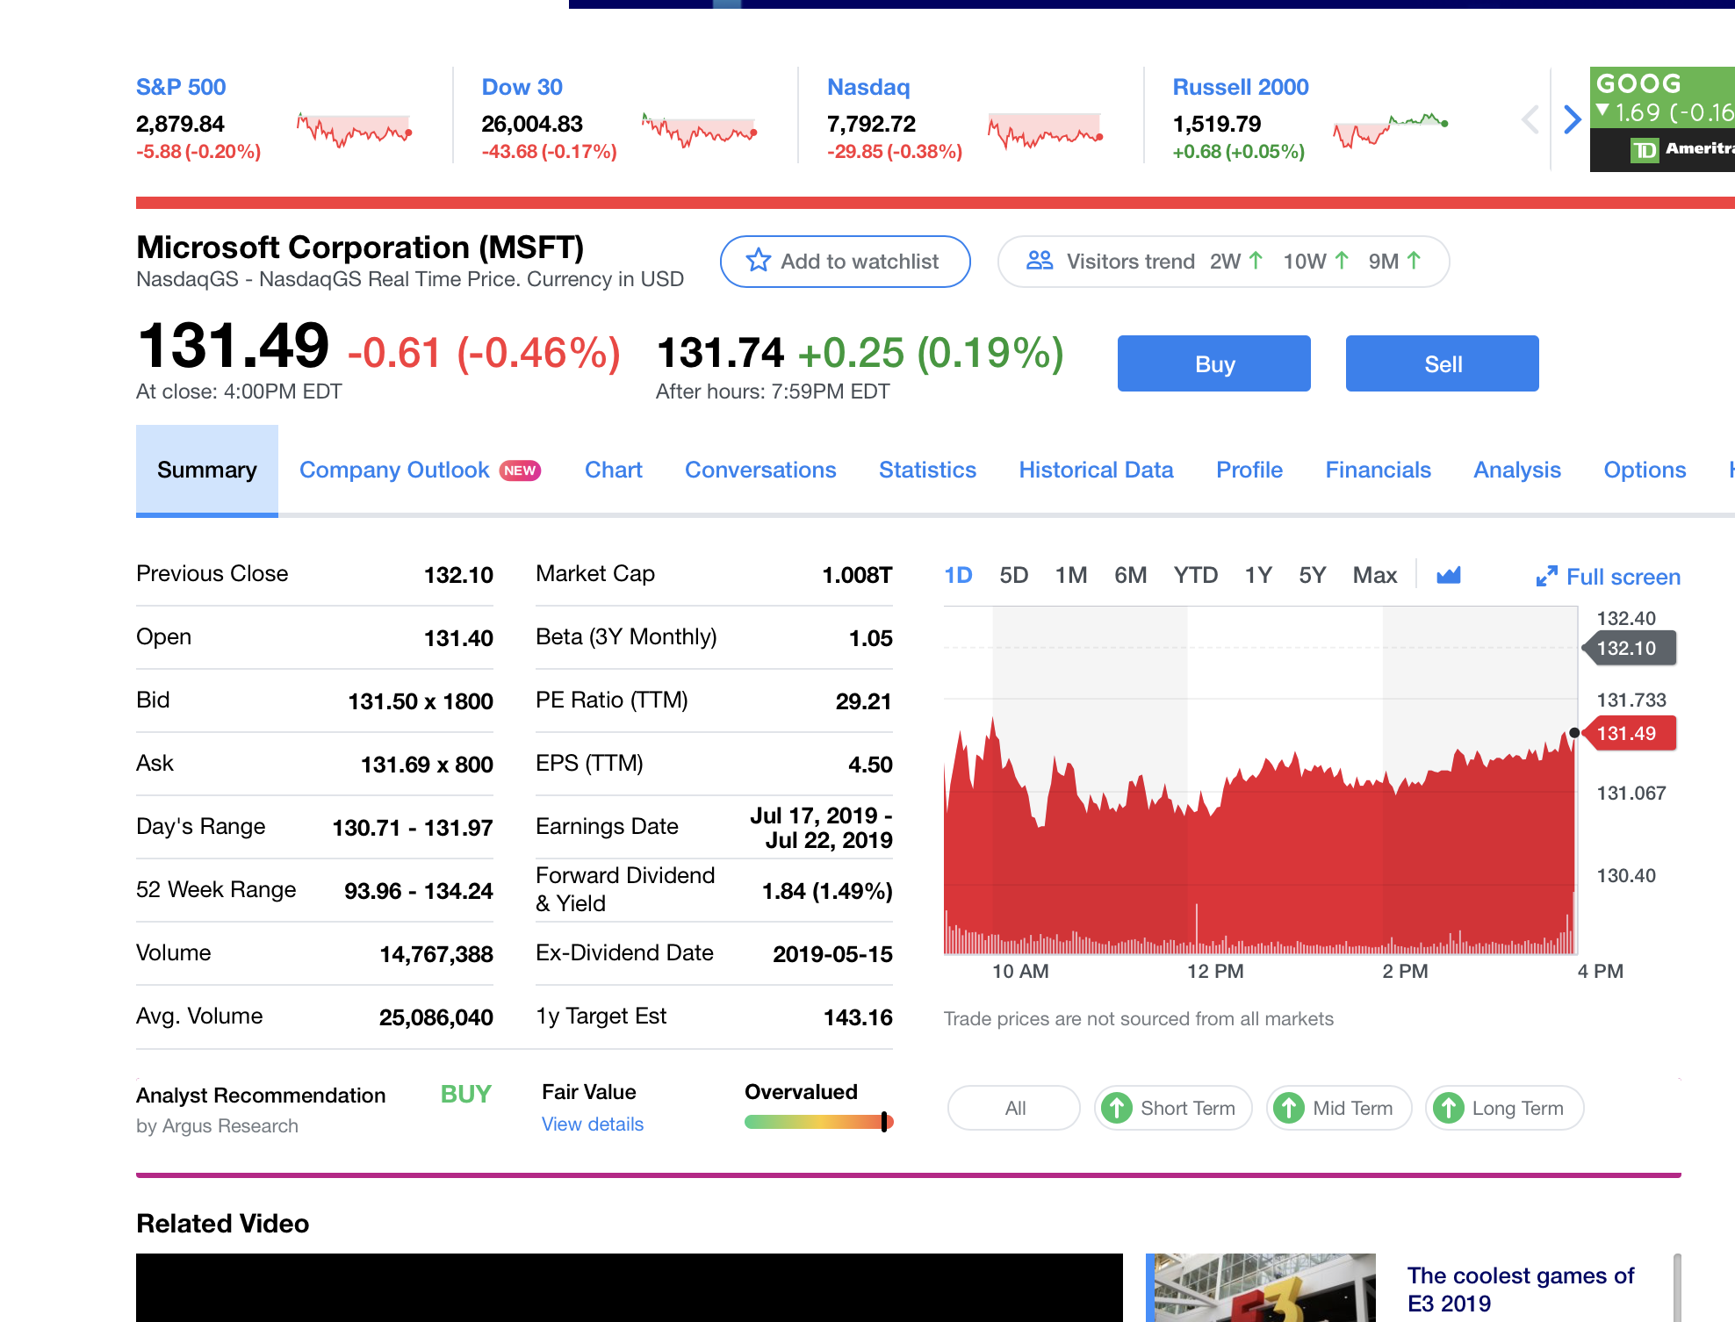
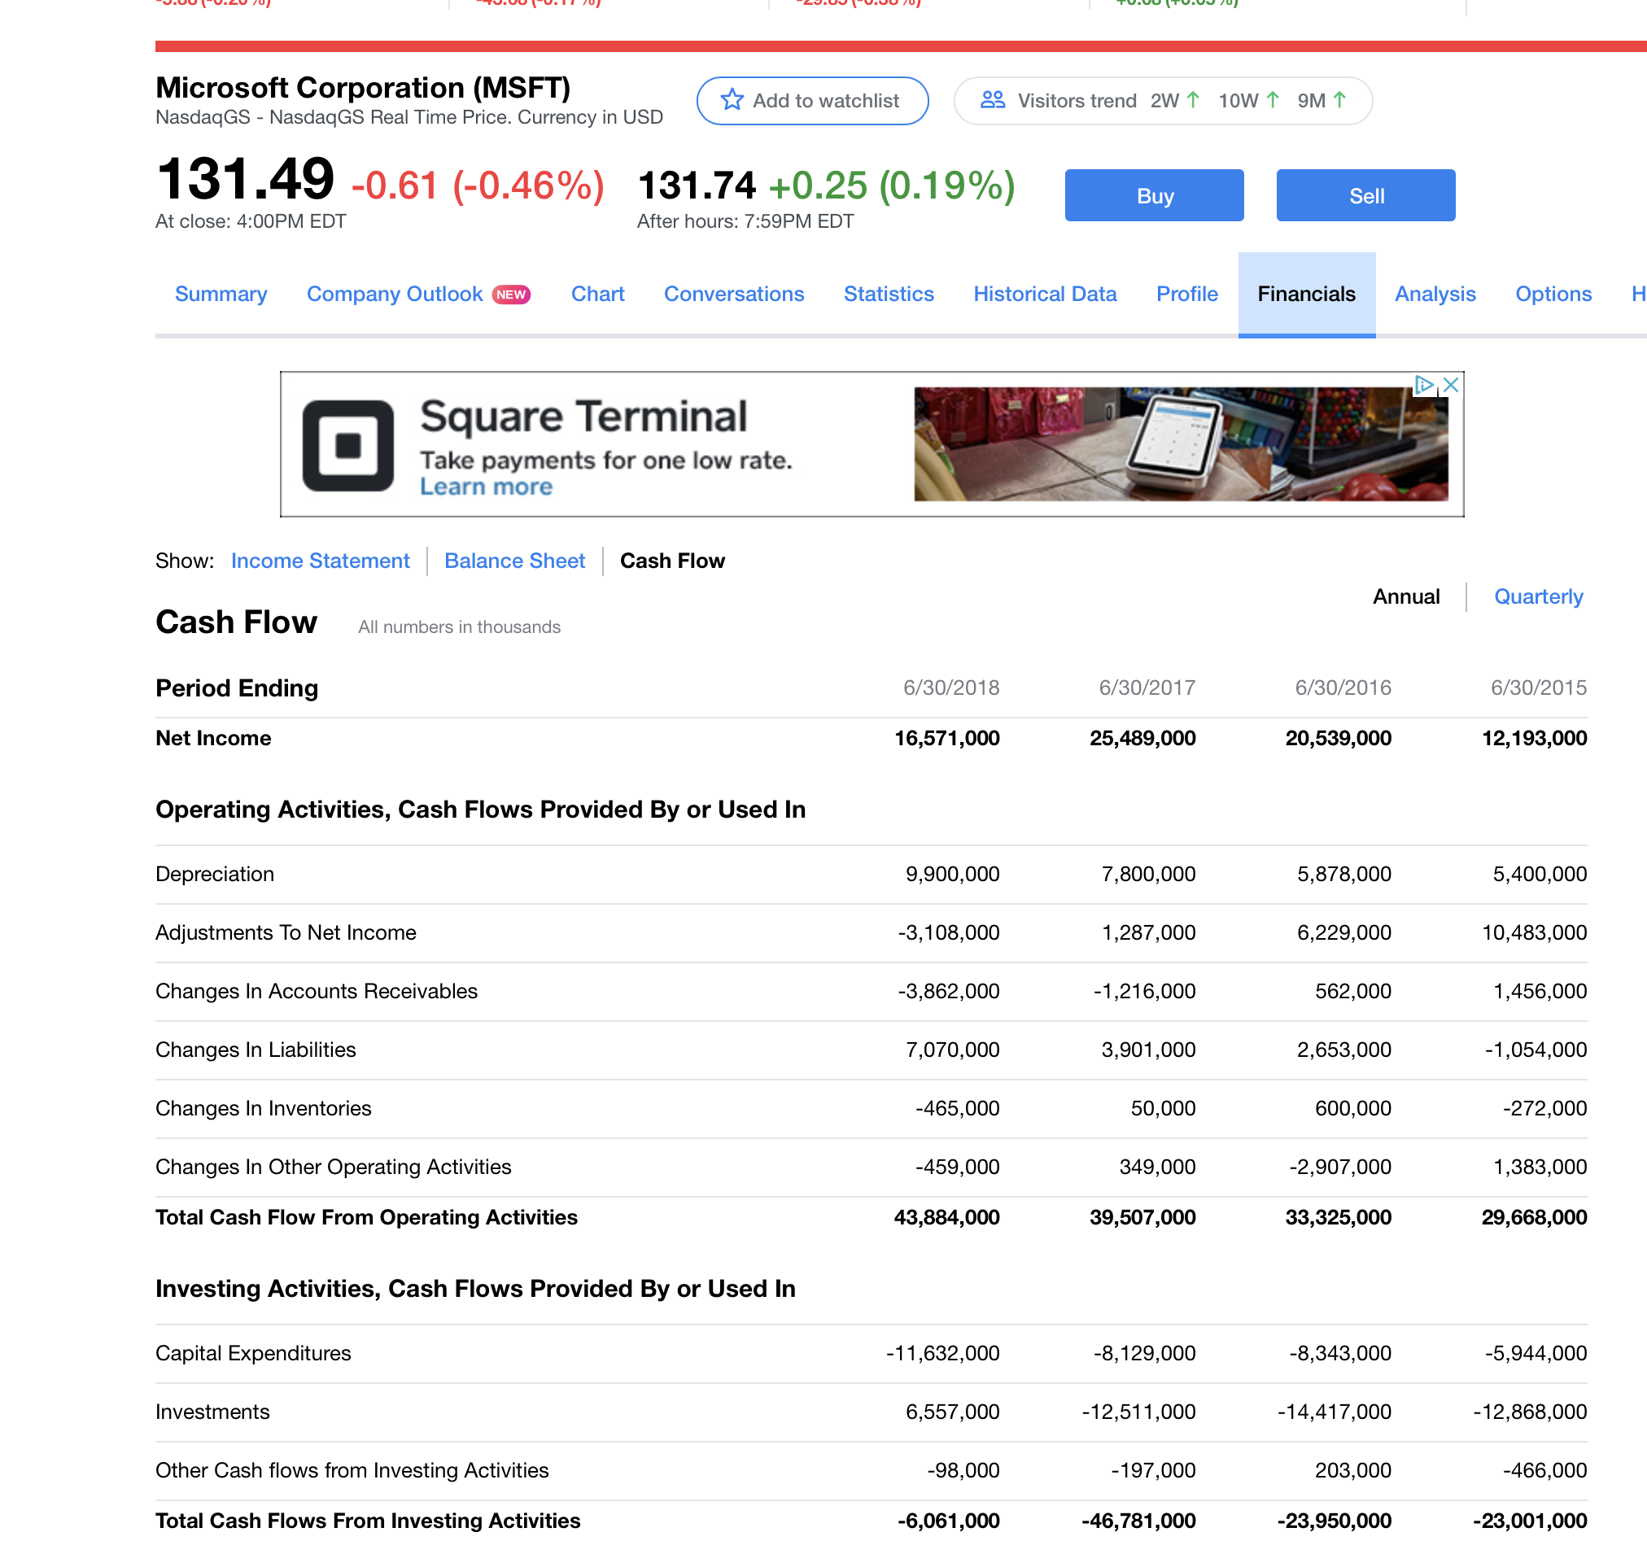
MGT8803 Business Fundamentals for Analytics Video Conference Call #6 Yahoo.com Assignment
(From Yahoo.com)
From Financials

Slide 7
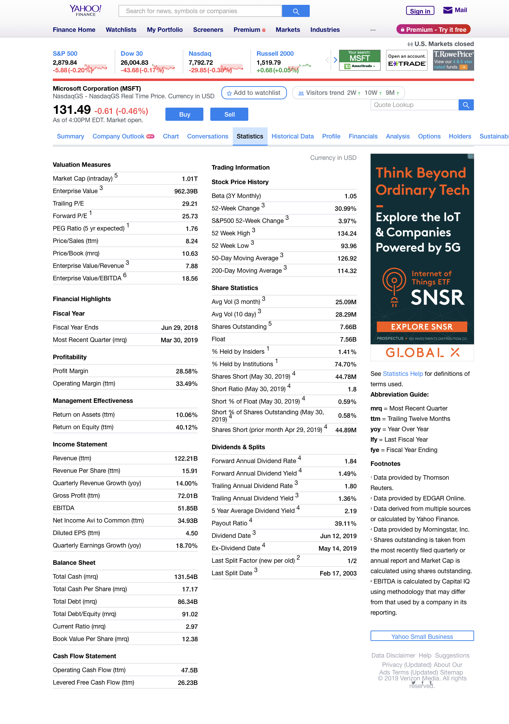
MGT8803 Business Fundamentals for Analytics Video Conference Call #6 Yahoo.com Assignment
(From Yahoo.com)
Stock Price
Market Cap (Market Value)
beta
Number of Shares Outstanding
Total Debt
Book Value/Share

Slide 8
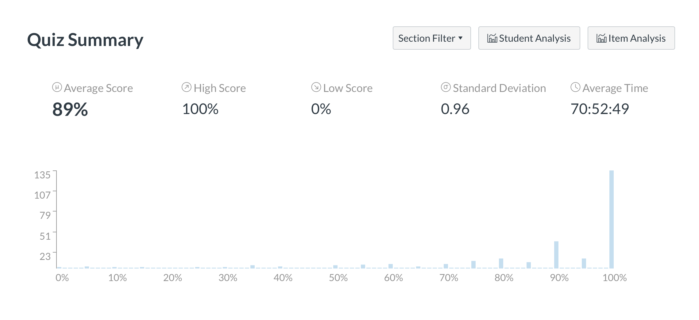
Video Conference Call #6 Managerial Accounting Homework #2 Results
Question %correct
1 95%
2 93%
3 89%
4 87%
5 79%
6 91%
7 79%
8 89%
9 92%

